Slide 1
INTRODUCTION TO JAVASCRIPT

Slide 2
What is Javascript
JavaScript is the programming language of HTML and the Web.
Why Study JavaScript?
JavaScript is one of the 3 languages all web developers must learn:
1. HTML to define the content of web pages
2. CSS to specify the layout of web pages
3. JavaScript to program the behavior of web pages

Slide 3
Exercise Project
You are required to produce an interface similar to the one in the next slide using HTML, CSS.
When a user clicks the “Google Search” button, validation should be done to check whether or not they typed something in the search field. If they did, then the user should get an alert with what they typed. Otherwise they should be advised to type something.

Slide 4
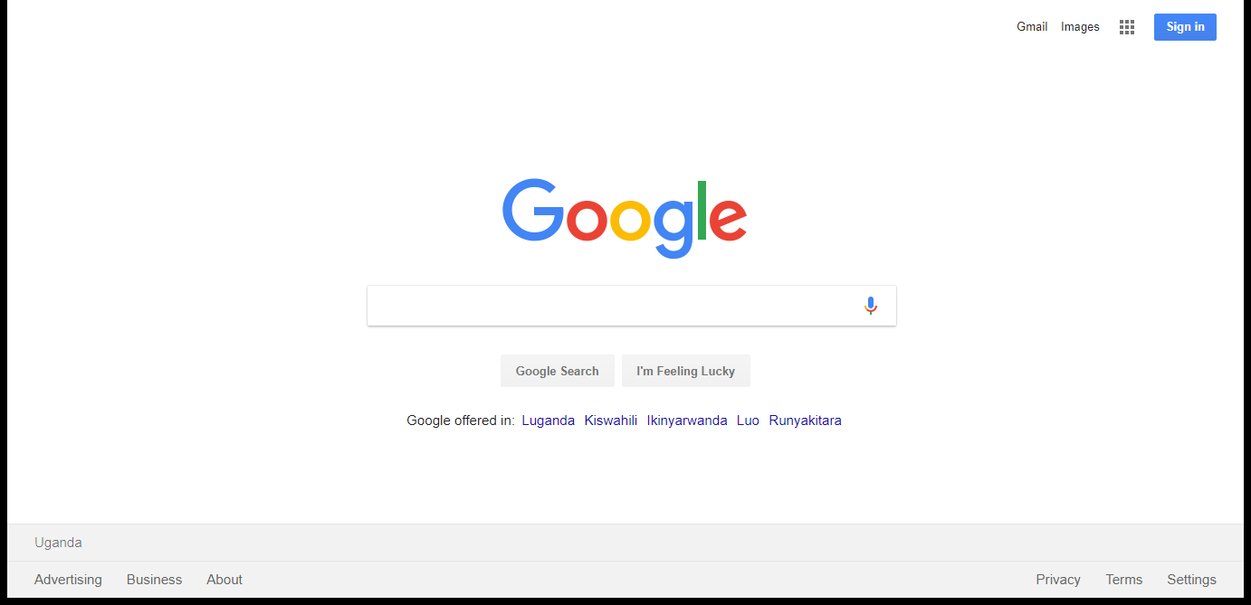
Exercise

